Slide 1
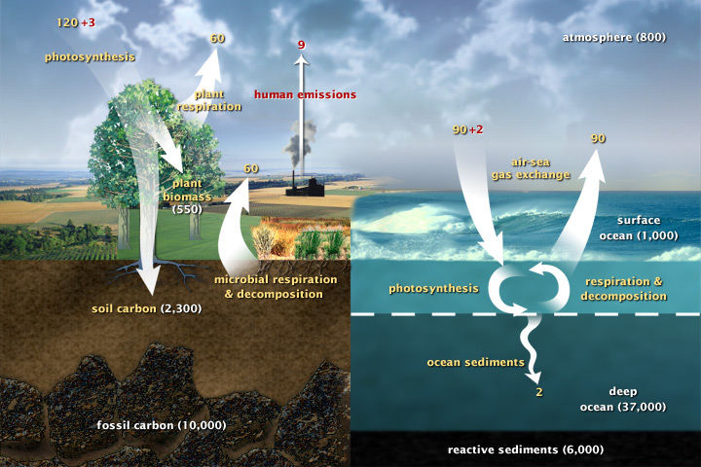
Carbon fluxes in Earth’s climate system

Slide 2
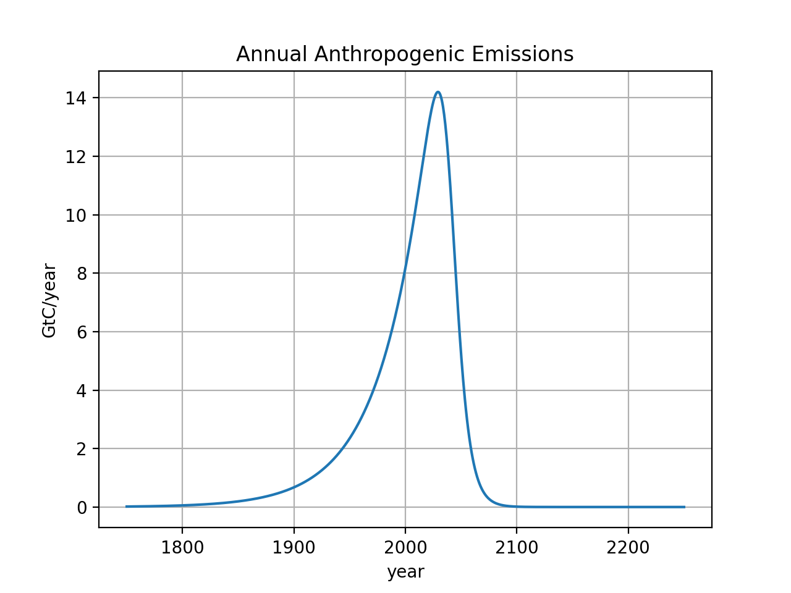
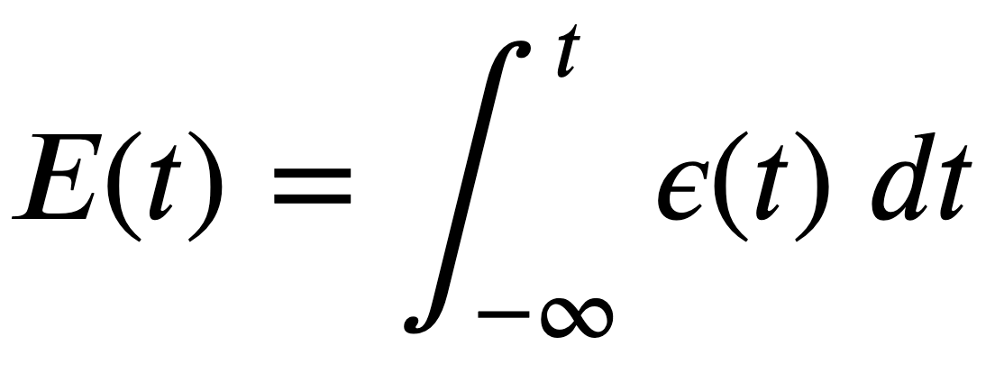
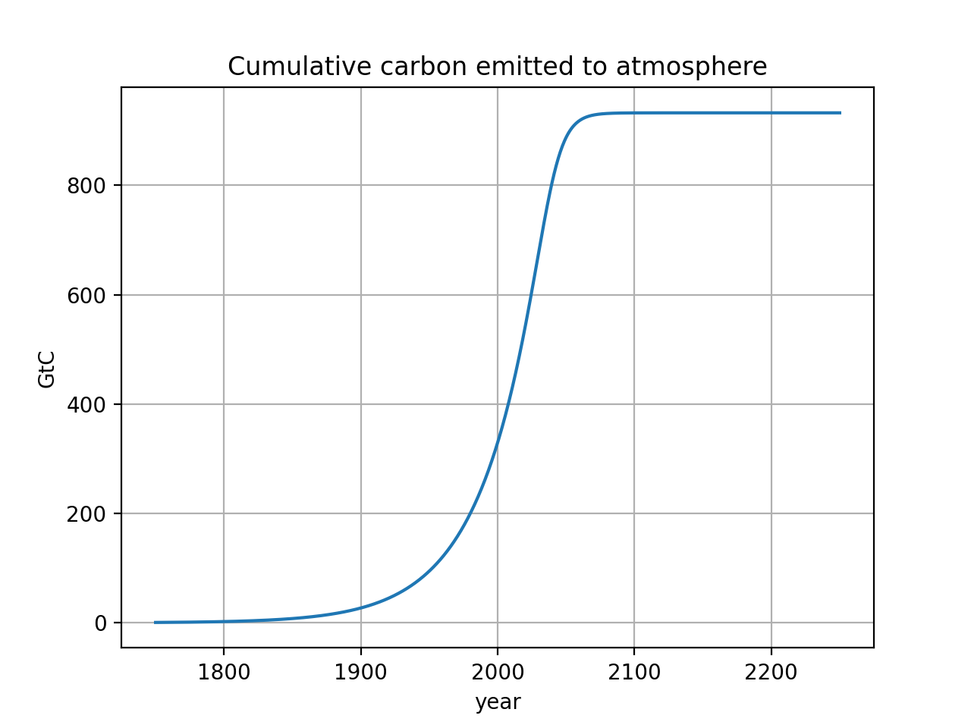

Math behind CumulativeAnalysis
Integral calculus:
$\sim 1000$ GtC burned in this scenario
It’s thought that ~4000 GtC is the total Earth reserve, so ~75% would be left in the ground
Notes:
http://www.igbp.net/news/features/features/havewereachedpeakco2.5.1b8ae20512db692f2a680003465.html

Slide 3
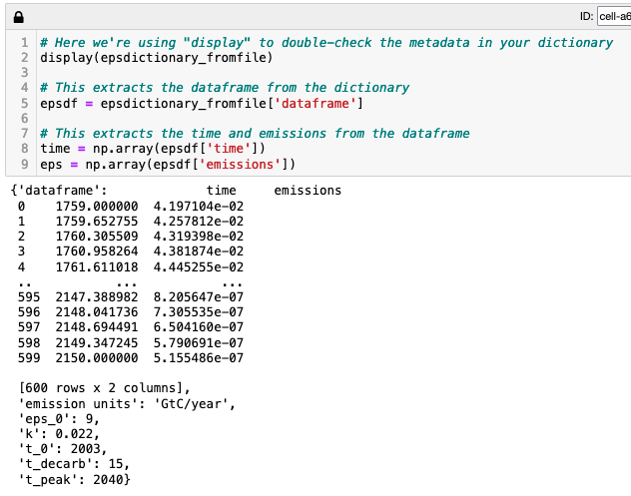
You have to load your scenario
Notes:
http://www.igbp.net/news/features/features/havewereachedpeakco2.5.1b8ae20512db692f2a680003465.html

Slide 4

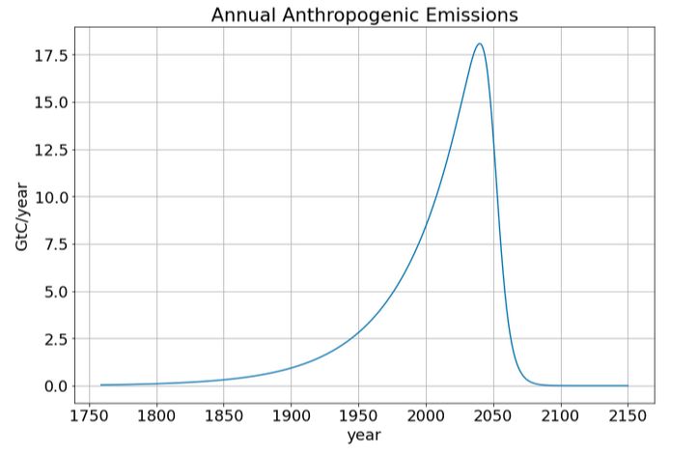
Then make sure it’s correct
Notes:
http://www.igbp.net/news/features/features/havewereachedpeakco2.5.1b8ae20512db692f2a680003465.html

Slide 5
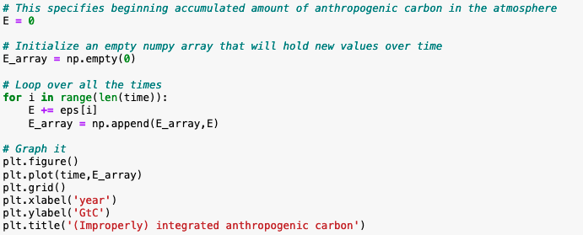
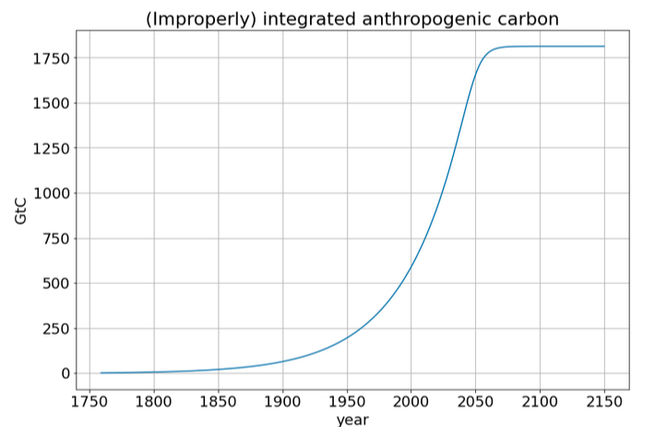
This not quite the correct integration (but it’s close)
Integral calculus:
Notes:
http://www.igbp.net/news/features/features/havewereachedpeakco2.5.1b8ae20512db692f2a680003465.html

Slide 6
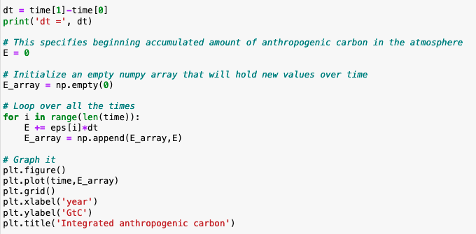
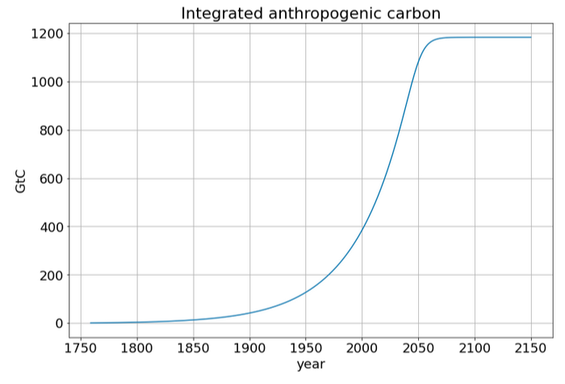
Here’s the correct solution
Integral calculus:
Notes:
http://www.igbp.net/news/features/features/havewereachedpeakco2.5.1b8ae20512db692f2a680003465.html

Slide 7
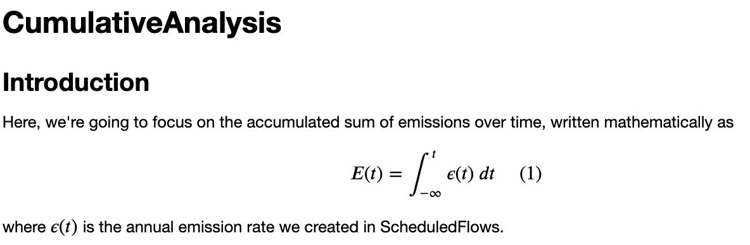
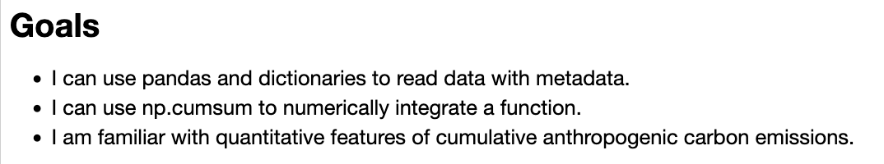
OK, let’s get started
Notes:
Predict the temperature if CO2 continues to rise. If we reduce CO2 emissions to zero.

